Slide 1
REGRESSION

Slide 2
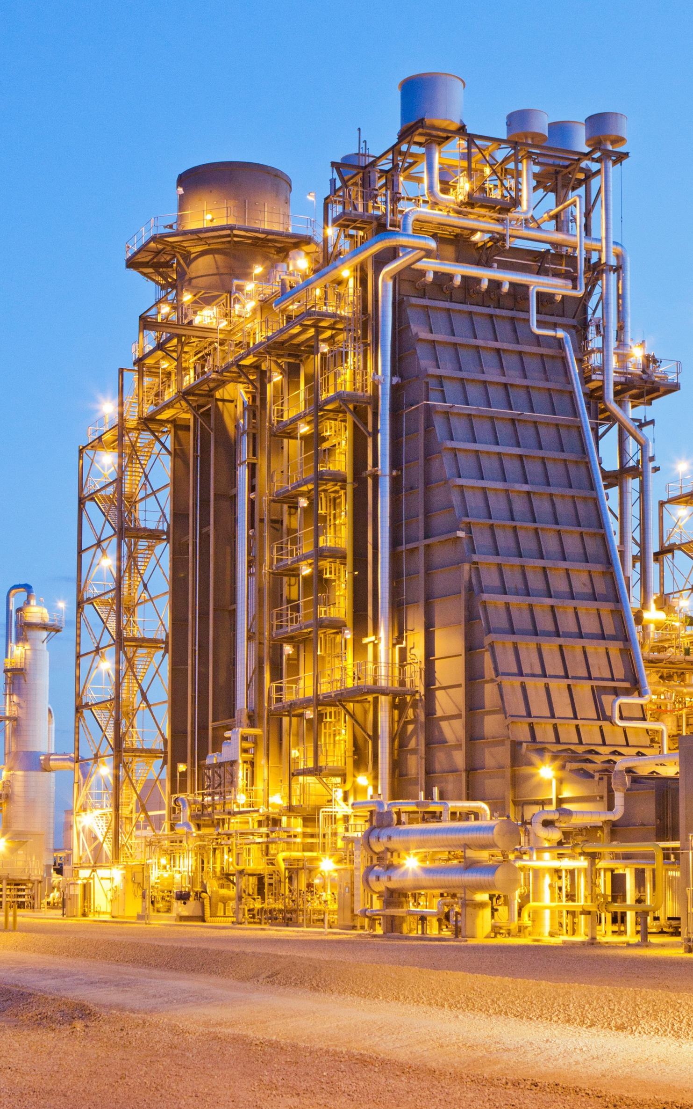
Daftar
Isi
Combined-Cycle-Power-Plant-Energy-Prediction
slide 45.pptx
1. Project Objective:
- Optimize combined-cycle power plant performance.
2. Power Plant Configuration:
- Uses both gas turbines and steam turbines in a single cycle.
3. Modelling Inputs:
- Factors include exhaust vacuum, ambient conditions (temperature, pressure, humidity).
4. Modelling Outcome:
- Develop a predictive model for net hourly electrical energy output to enhance efficiency and improve overall energy generation.
REGRESSION

Slide 3
CONTENT
1. Section 1
Exploratory Data Analysis
2. Section 2
Plotly Dash Board
3. Section 3
Linear Regression
4. Section 4
Decision Tree regressor

Slide 4
CONTENT
5. Section 5
RANDOM FOREST REGRESSOR
6. Section 6
SVM (REGRESSOR)
7. Section 7
RANSAC REGRESSION
8. Section 8
STACKING REGRESSION
9. Section 9
MODEL VALIDATION
DEPLOYMENT

Slide 5


1
Checking For Null Values and Dull values.
2
Visualizing the Distribution of Continuous Features with the help of Histograms and Probability Plot.
IMPORTED LIBRARIES
We have done the data analysis and machine learning using libraries such as NumPy, Pandas, PyArrow, Seaborn, Matplotlib, and scikit-learn. It incorporates linear regression models (Ridge, Lasso), statistical tests (Shapiro-Wilk, normality tests), and diagnostic tools. Pre-processing steps involve scaling, transforming functions, and assessing multicollinearity using VIF. Support Vector Regression (SVR) is implemented, and performance metrics (mean squared error, R-squared, mean absolute error) are used for model evaluation. The script concludes with data splitting and normalization.
Exploratory Data Analysis
3
The Shapiro-Wilk test.
Log transformation and visualizing the Histogram to determine any possible changes in distribution
4
Square root transformation and visualizing the Histogram to determine any possible changes in distribution.

Slide 6

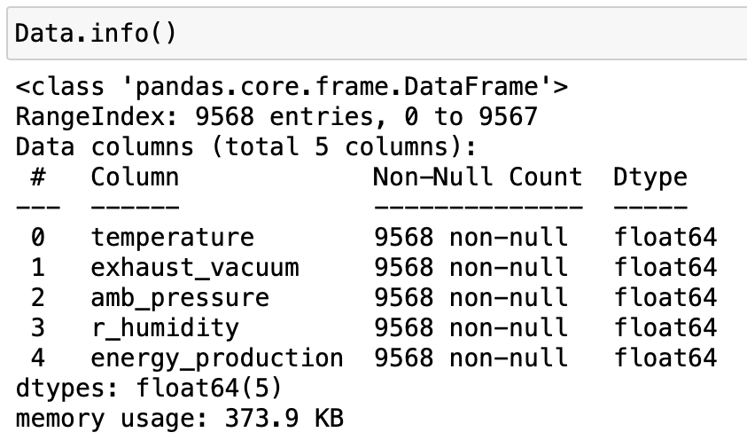

5
Cuberoot transformation and visualizing the Histogram to determine any possible changes in distribution and Boxcox Transformations
DATASET INFORMATION
6
Visualizing the Relation between each independent Feature with respect to the Dependent Feature
Exploratory Data Analysis
7
Visualizing Continuous Datatype for Outlier Detection
8
Median, Mean Imputation to handle Outlier in r_humiditya and amb_pressure
This Photo by Unknown Author is licensed under CC BY-ND

Slide 7

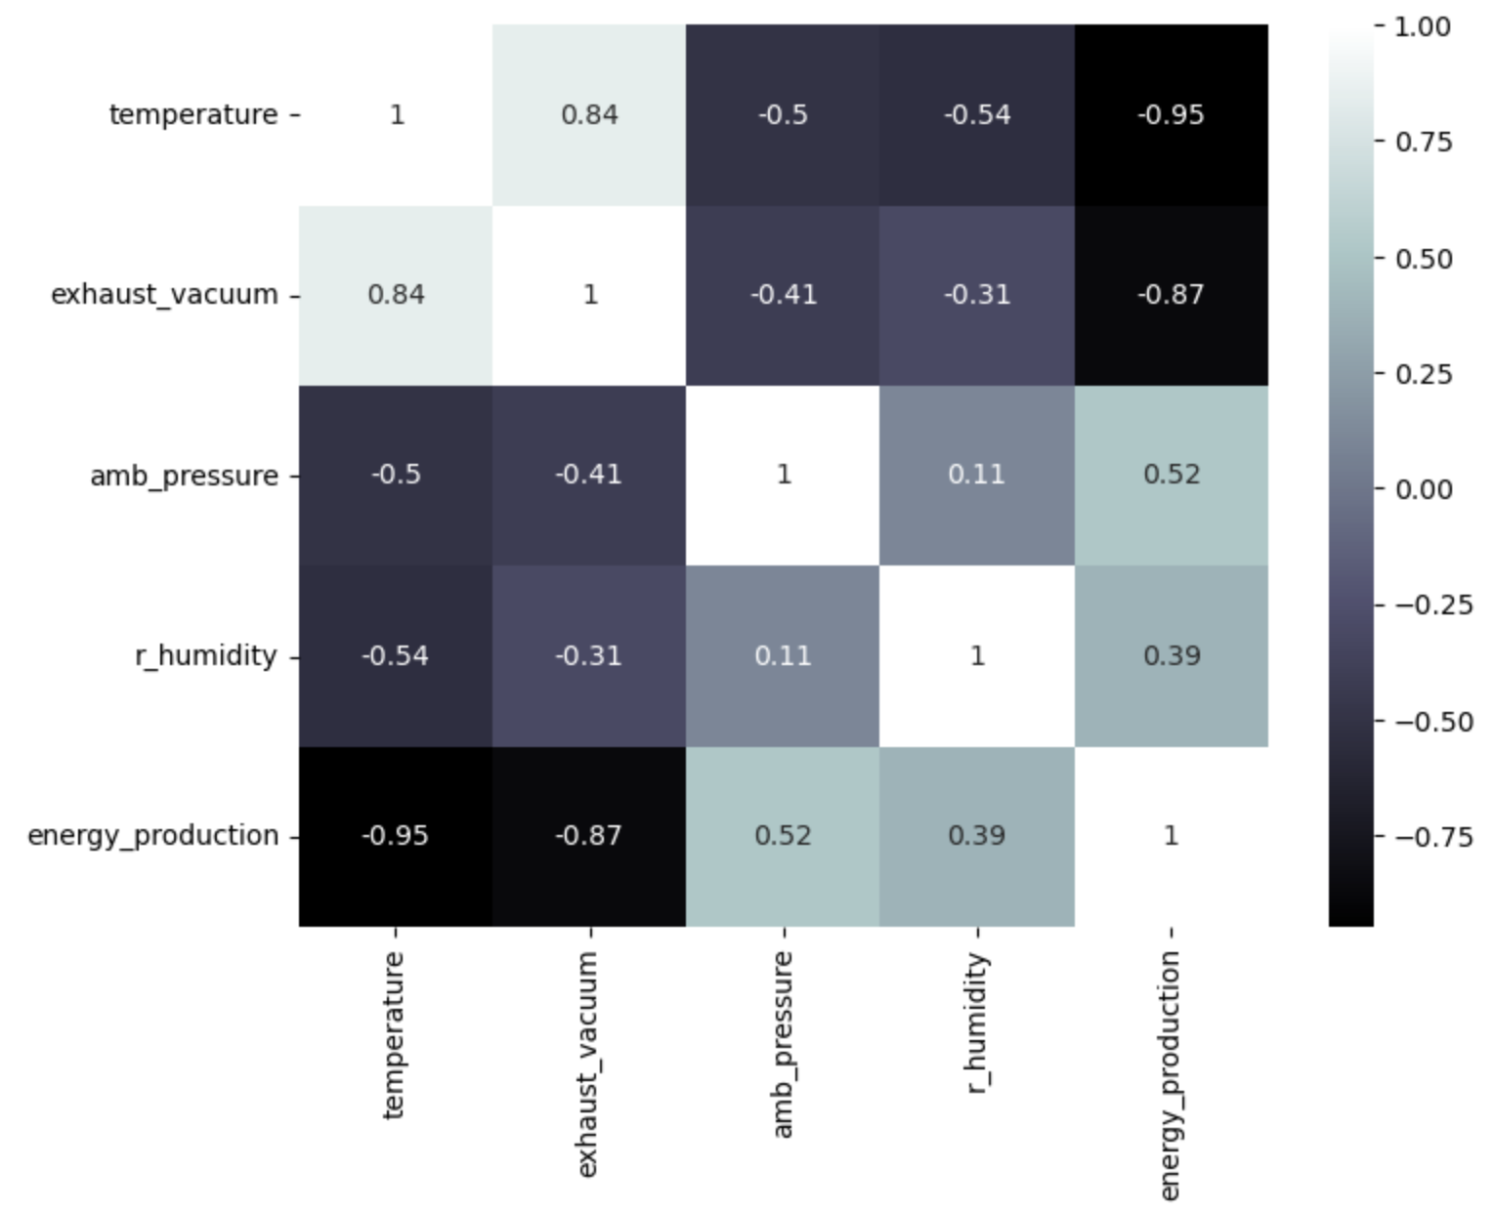
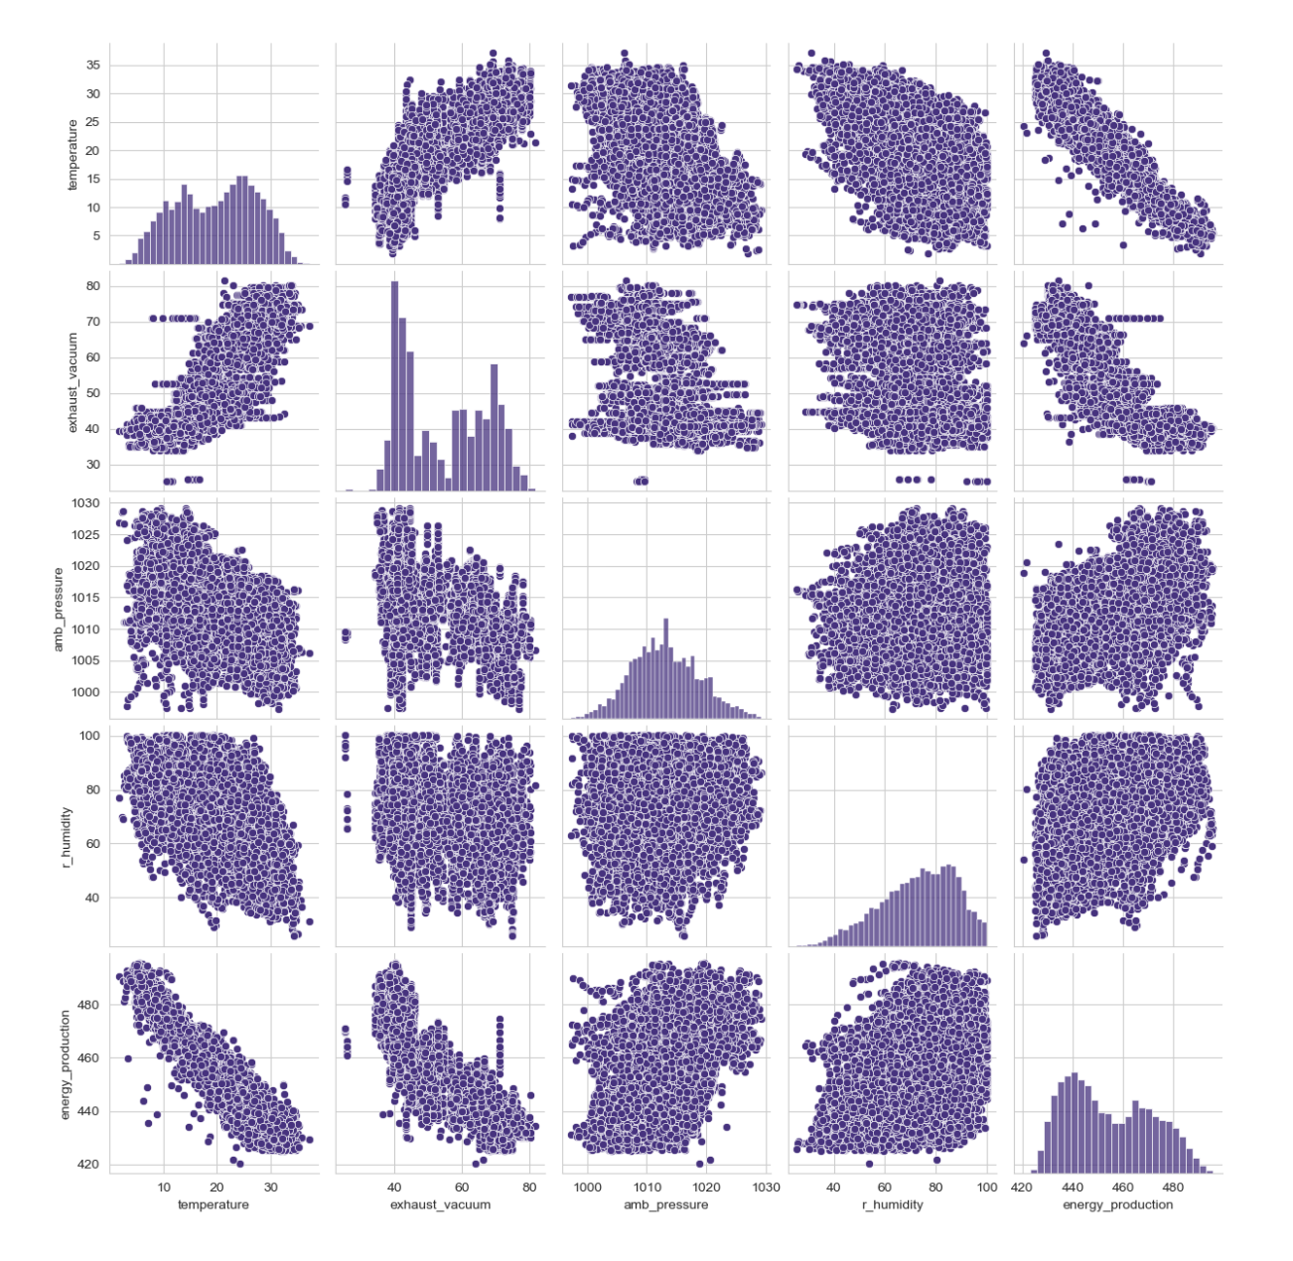

9
Testing our data in model and find the R-squared with mean imputation data model.
Observation: After mean imputation the model is performing well.
Exploratory Data Analysis
10
Removing the Outliers and then finding the R-Squared Value.
Observation: we are getting high r-squared value in mean imputation ,so we will proceed with that.

Slide 8
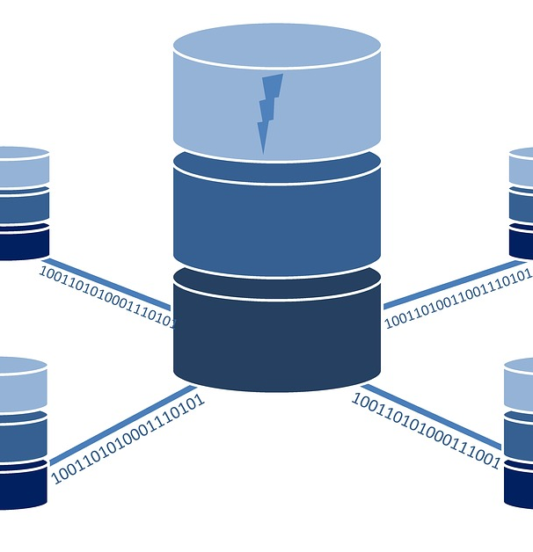
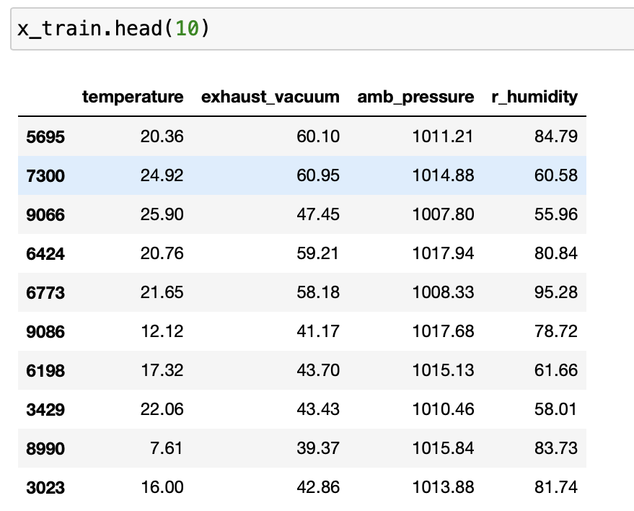
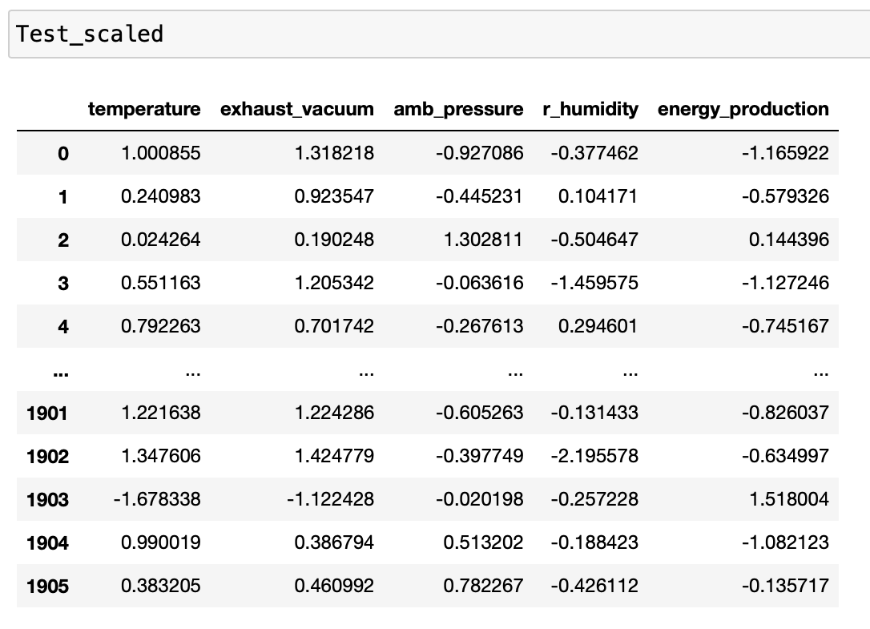

1
Splitting Dataset
Train and Test split
Plotly Dash Board
2
Scaling Data
Train and Test scaled.

Slide 9

4
Linear Regression
6
5

Slide 10

4
Linear Regression
Calculating VIF
6
5

Slide 11

4
Linear Regression
Calculating VIF
6
5
Residual Analysis
Test of normality of residuals
Residuala Plot for Homoscedasticity
Residual Vs Regressors

Slide 12

4
Linear Regression
Detecting Outliers
Calculating VIF
Cook’s Distance
High influence Points
6
5
Residual Analysis
Test of normality of residuals
Residual Plot for Homoscedasticity
Residual Vs Regressors

Slide 13

Linear Regression
4
Detecting Outliers
Calculating VIF
Cook’s Distance
High influence Points
6
5
Residual Analysis
Improving the model
Test of normality of residuals
Residual Plot for Homoscedasticity
Residual Vs Regressors
4

Slide 14
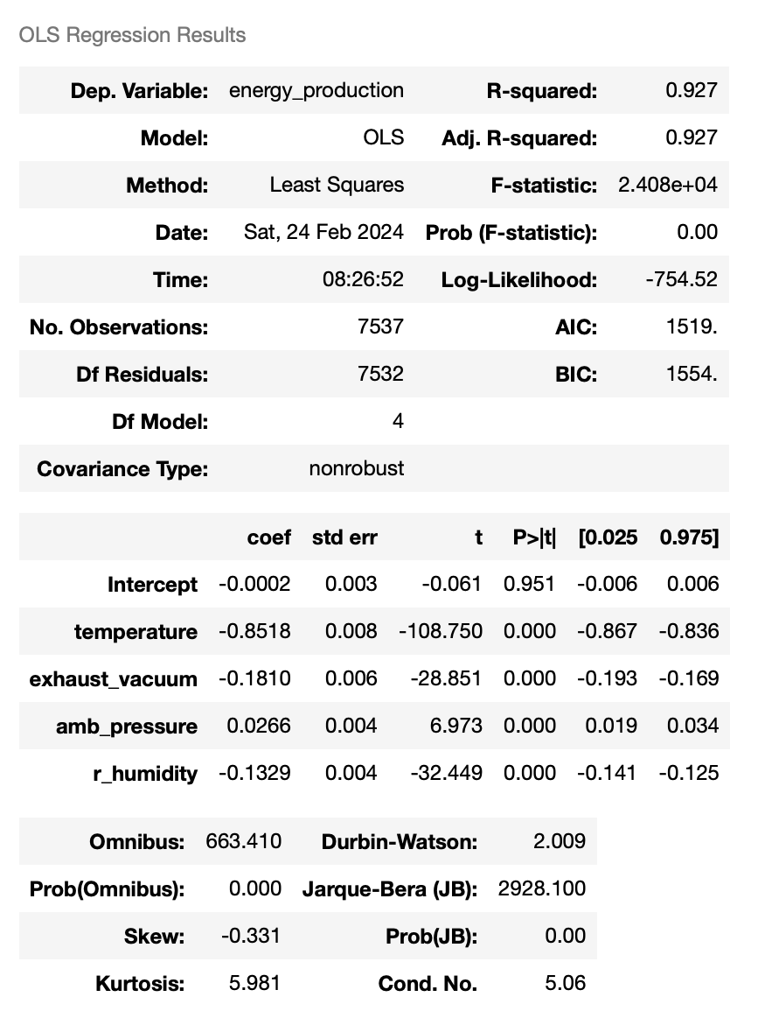
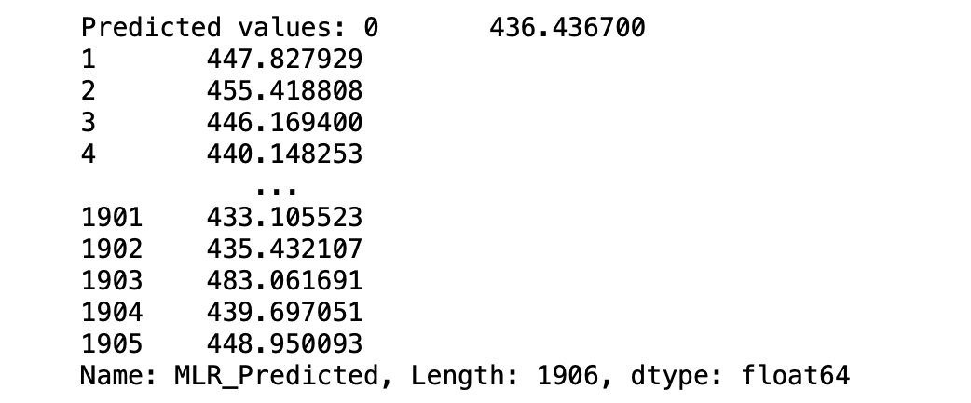

Chart Title
2023
56%
26%
2022
68%
6
37%
5
2021
47%
14%
4
96%
Conclusion
2020
84%
MSE:0.0712853282401689 RMSE:0.2669931239567208 MAE:0.21307904876323788 R-squared: 0.9287146717598311

Slide 15
4
Decision Tree regressor
6
5

Slide 16
Decision Tree regressor
4
Grid search CV for best
hyperparameters of
our Tree model.
6
5

Slide 17
Decision Tree regressor
4
Grid search CV for best
hyperparameters of
our Tree model.
6
5
Testing Accuracy for
DT Model
4

Slide 18
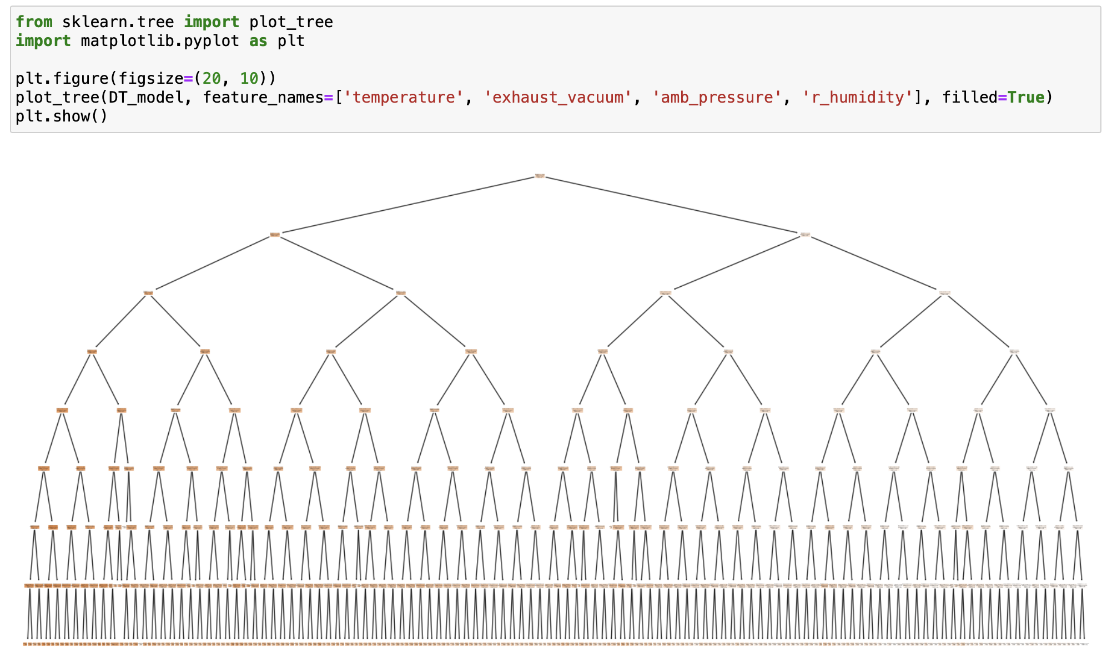
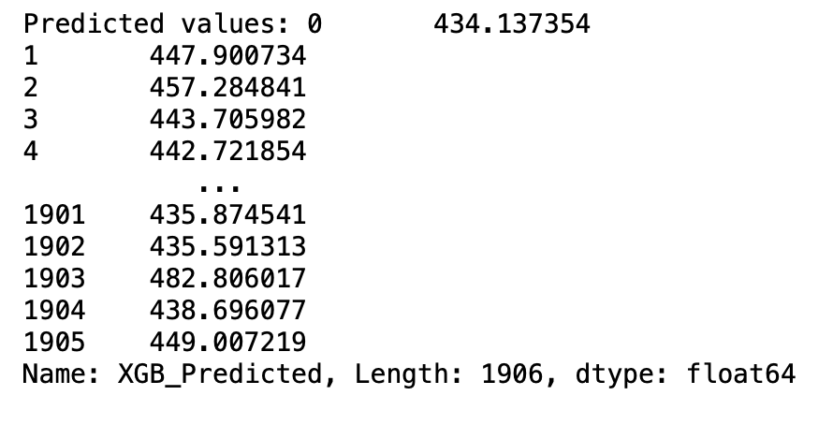
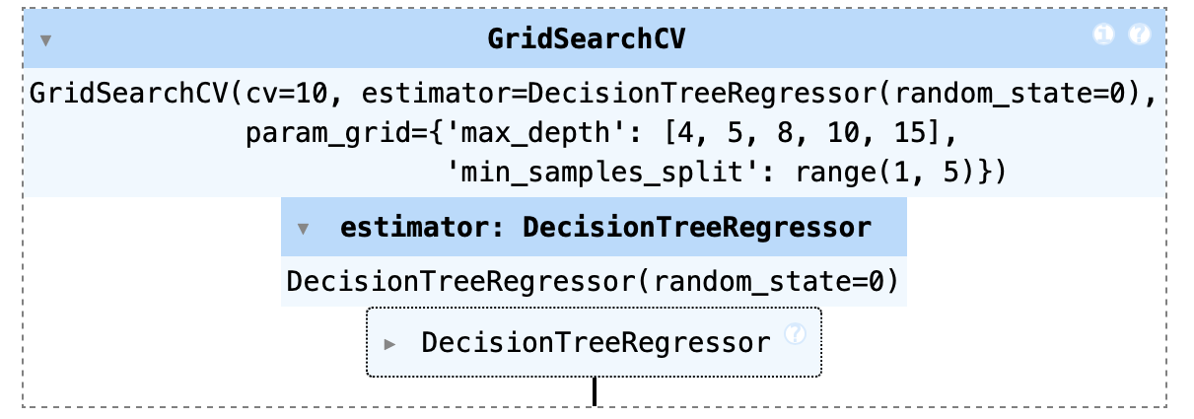
art Title
2023
56%
26%
2022
68%
6
37%
5
2021
47%
14%
4
Conclusion
2020
96%
84%
Mean Squared Error: 0.06184344657456588
R-squared: 0.9381565534254341
So this DT model performs better than MLR model based on R squared values....

Slide 19
4
RANDOM FOREST REGRESSOR
6
5

Slide 20
RANDOM FOREST REGRESSOR
4
Importing Random Forest Regressor and
Displaying all parameters with
best scores.
6
5

Slide 21
RANDOM FOREST REGRESSOR
Importing Random Forest Regressor and
Displaying all parameters with
best scores.
4
6
5
Testing Accuracy for
Random Forest Regressor
4

Slide 22
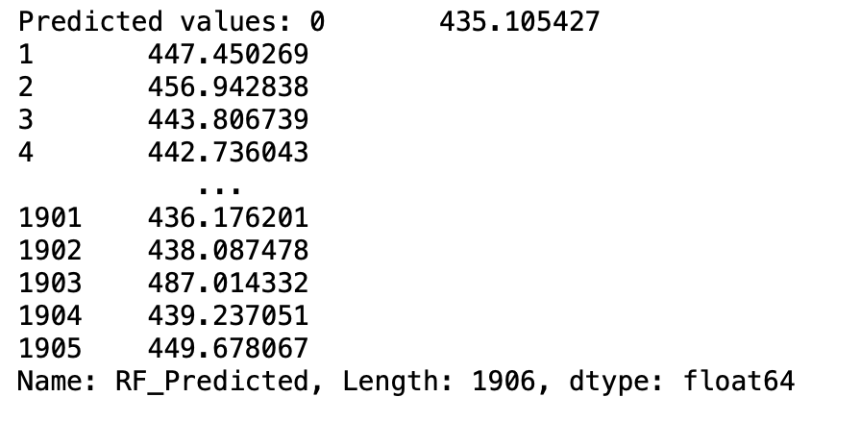
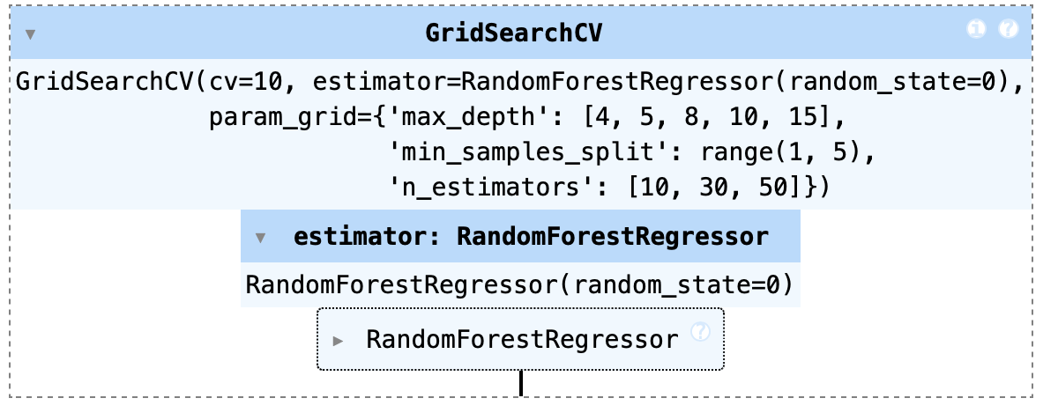
art Title
2023
56%
26%
2022
68%
6
37%
5
2021
47%
14%
4
Conclusion
2020
84%
Mean Squared Error: 0.044093571530376255
R-squared: 0.9559064284696238

Slide 23
SVM (REGRESSOR)
4
6
5

Slide 24
SVM (REGRESSOR)
4
Importing svr and
Displaying all parameters with
best scores.
6
5

Slide 25
SVM (REGRESSOR)
Importing svr and
Displaying all parameters with
best scores.
4
6
5
Testing Accuracy for
SVM
4

Slide 26
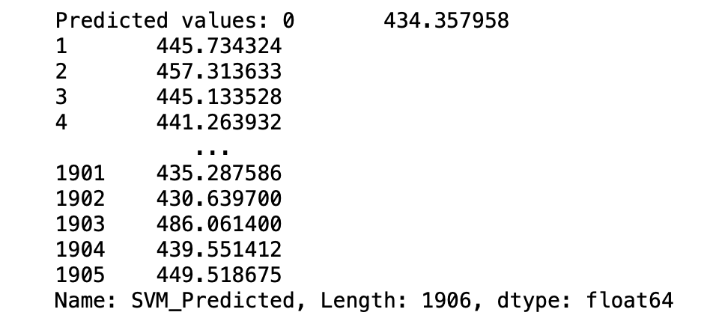
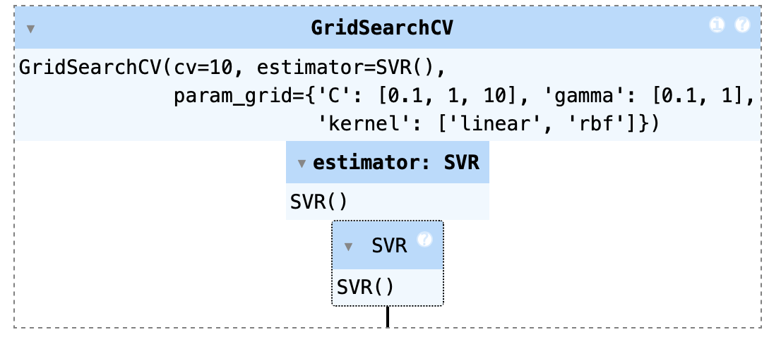
art Title
2023
56%
26%
2022
68%
6
37%
5
2021
47%
14%
4
Conclusion
2020
96%
84%
Mean Squared Error: 0.05126948659056881
R-squared: 0.9487305134094312

Slide 27
RANSAC REGRESSION
4
6
5

Slide 28
RANSAC REGRESSION
4
Importing RANSACRegressor and
Fitting the model assuming
y_train as target variable and
making predictions on the test set.
6
5

Slide 29
RANSAC REGRESSION
Importing RANSACRegressor and
Fitting the model assuming
y_train as target variable and
making predictions on the test set.
4
6
5
Testing Accuracy for
RANSAC REGRESSION.
4

Slide 30
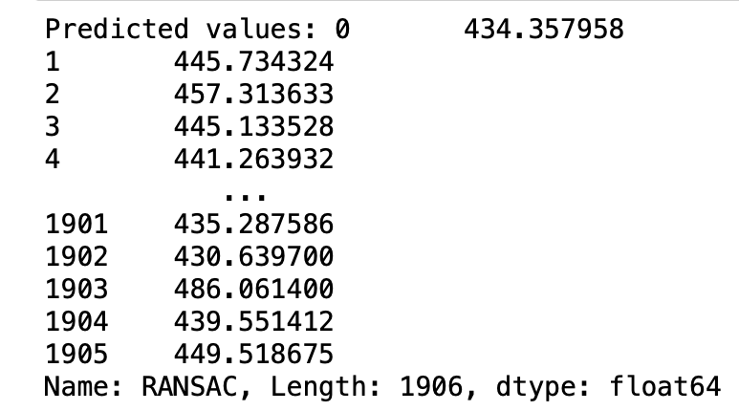
art Title
2023
56%
26%
2022
68%
6
37%
5
2021
47%
14%
4
Conclusion
2020
96%
84%
Mean Squared Error: 0.07423261961705206
R-squared Score: 0.9257673803829479

Slide 31
STACKING REGRESSOR
4
6
5

Slide 32
STACKING REGRESSOR
4
Importing StackingRegressor,
importing LinearRegression
importing RandomForestRegressor
and meta model is LinearRegression.
6
5

Slide 33
STACKING REGRESSOR
Importing StackingRegressor,
importing LinearRegression
importing RandomForestRegressor
and meta model is LinearRegression.
4
6
5
Testing Accuracy for
RANSAC REGRESSION.
4

Slide 34
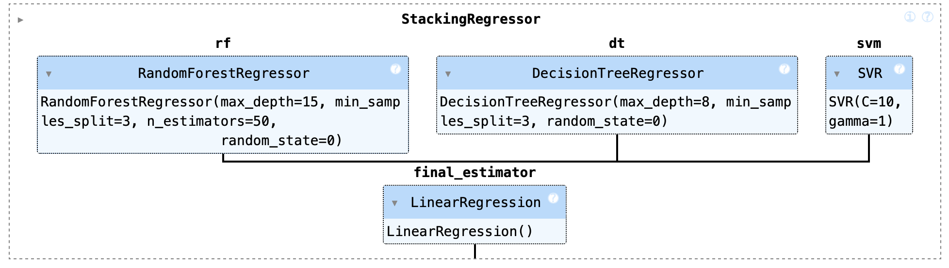
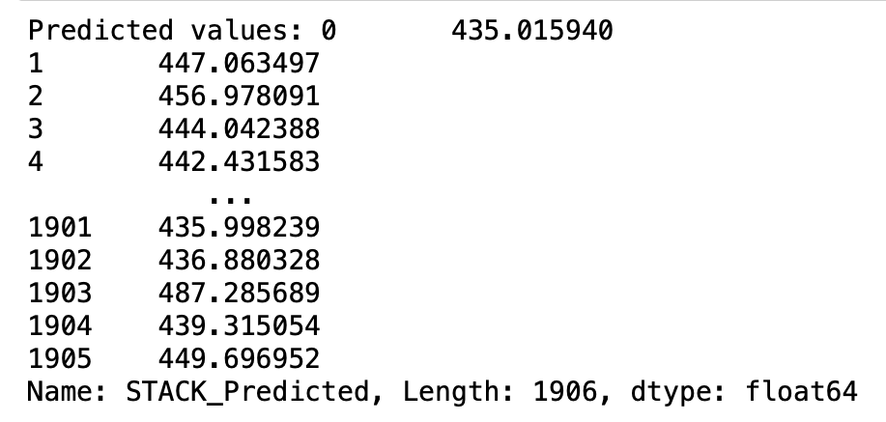
art Title
2023
56%
26%
2022
68%
6
37%
5
2021
47%
14%
4
Conclusion
2020
96%
84%
MSE of stack model: 0.05126948659056881
R-squared of stack model: 0.9567968973082562

Slide 35
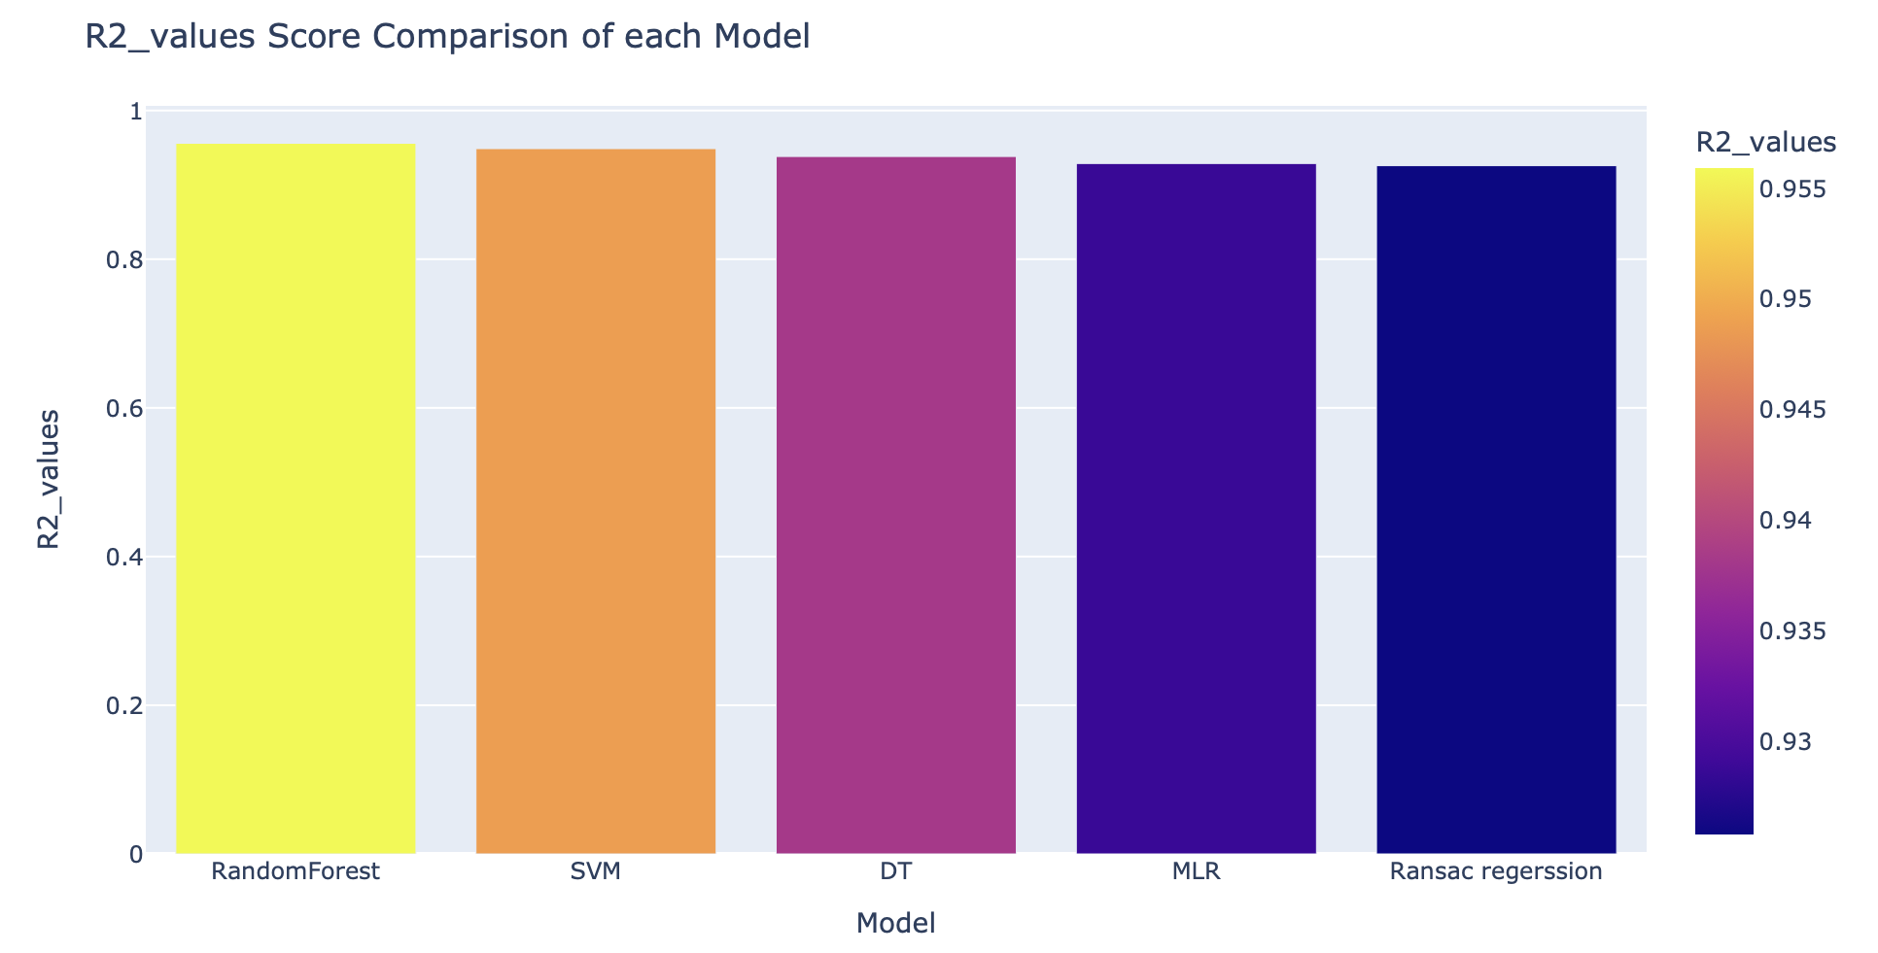
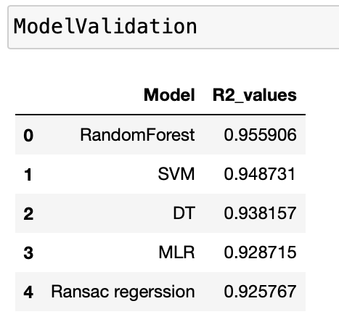
4
4
5
MODEL VALIDATION
6

Slide 36

Step
01
DEPLOYMENT
Step
02
4
Step
03
Step
04
4

Slide 37

Pickling the model for deployment
import pickle
pickle.dump(stacking_regressor,open('regmodel.pkl','wb'))
pickled_model=pickle.load(open('regmodel.pkl','rb'))
Step
01
DEPLOYMENT
Step
02
4
Step
03
Step
04

Slide 38
Pickling the model for deployment
import pickle
pickle.dump(stacking_regressor,open('regmodel.pkl','wb'))
pickled_model=pickle.load(open('regmodel.pkl','rb'))
Step
01
DEPLOYMENT
Step
02
4
Load the trained regression model from the pickle file
Create a DataFrame with the input features
Step
03
Step
04

Slide 39
Pickling the model for deployment
import pickle
pickle.dump(stacking_regressor,open('regmodel.pkl','wb'))
pickled_model=pickle.load(open('regmodel.pkl','rb'))
Step
01
DEPLOYMENT
Step
02
4
Load the trained regression model from the pickle file
Create a DataFrame with the input features
Make a prediction using the loaded regression model
Display the predicted energy production
Step
03
Step
04

Slide 40

Pickling the model for deployment
import pickle
pickle.dump(stacking_regressor,open('regmodel.pkl','wb'))
pickled_model=pickle.load(open('regmodel.pkl','rb'))
Step
01
DEPLOYMENT
Step
02
4
Load the trained regression model from the pickle file
Create a DataFrame with the input features
Make a prediction using the loaded regression model
Display the predicted energy production
Step
03
Creating a personal environment and install all the library in the environment and activate using below codes :-
#!source myenv/bin/activate
#streamlit run regression1.py
Step
04

Slide 41
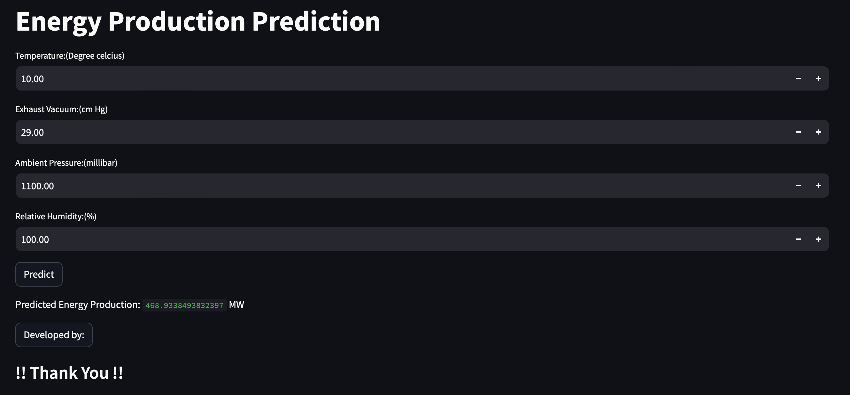
4
4
DEPLOYMENT
5
You can now view your Streamlit app in your browser.
Local URL: http://localhost:8504
Network URL: http://192.168.1.4:8504
6

Slide 42

4
4
THANK YOU
5
Group : 6 (Team Members) :-
Praveen Kumar
Shruti Gupta
Shweta Barnwal
Abhinav Kumbalwar
Nilesh Bajgude
Keshav Chaudhary
Dhanush Kumar K
6
This Photo by Unknown Author is licensed under CC BY

